Slide 1



Circularity, Entropy, Ecological Conflicts, LFFU
Centre for World Environment History,
University of Sussex UK
Joan Martinez-Alier|
30 April 2021

Slide 2

The industrial economy is not circular –it is entropic (NGR, 1971). Hence many ecological conflicts at the frontiers of commodity extraction and waste disposal.

Slide 3
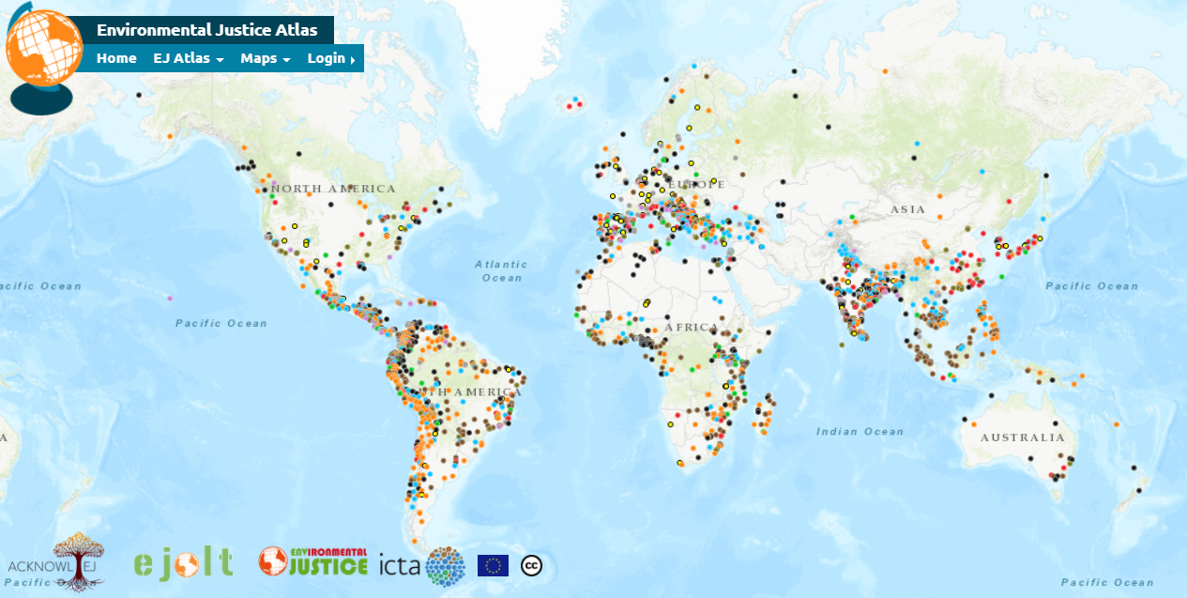
The EJAtlas (www.ejatlas.org) 3450 cases by May, 2021.

Slide 4
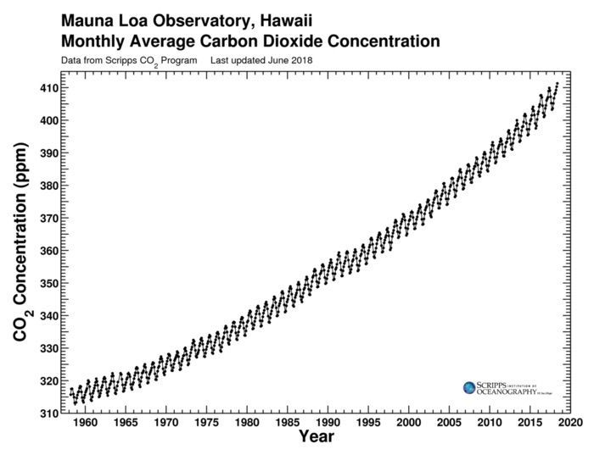
The Keeling curve, reaching 420 ppm

Slide 5
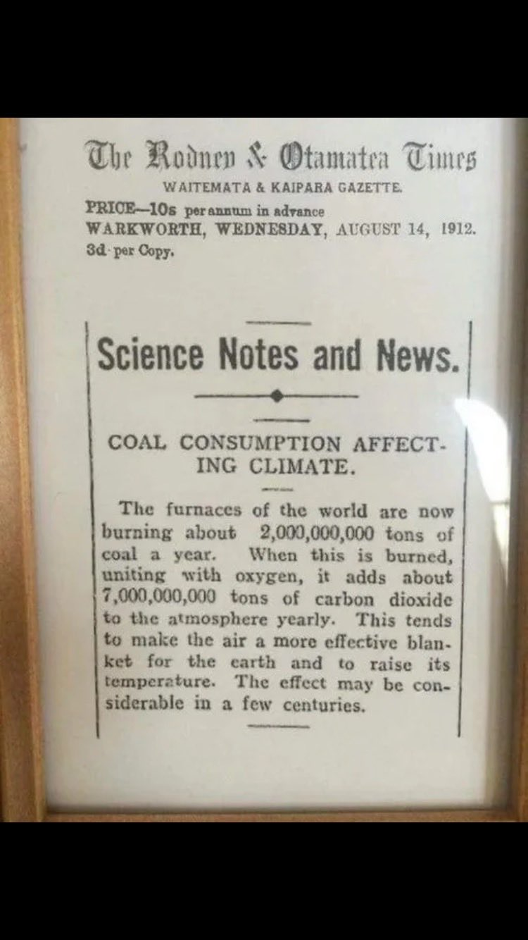

Slide 6
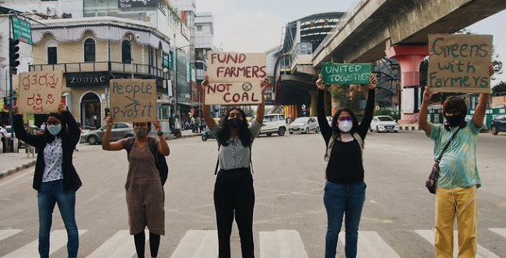
Source: https://www.thenewsminute.com/article/fridays-future-was-govt-radar-long-disha-ravis-arrest-inside-view-143502

Slide 7
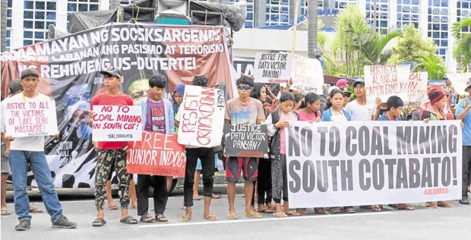
Source: Against coal mining in South Cotabato, Philippines.
https://ejatlas.org/conflict/coal-mining-in-barangay-ned-south-cotabato-philippines

Slide 8
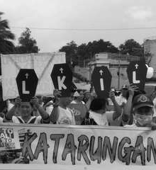

Source: Climate Justice movement against coal in the Philippines.
The murder of Gloria Capitan. https://ejatlas.org/conflict/coal-mining-leading-to-the-killing-of-gloria-capitan

Slide 9
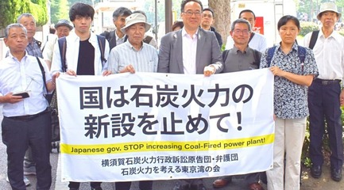
Source: . https://beyond-coal.jp/local-activities/yokosuka/.
https://ejatlas.org/conflict/yokosuka-coal-power-plant

Slide 10
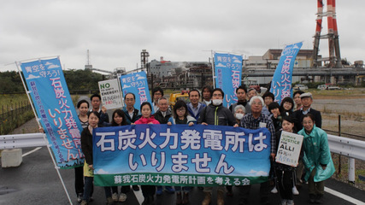
Source: Kiko network. https://ejatlas.org/conflict/soga-coal-poer-chiba-japan

Slide 11
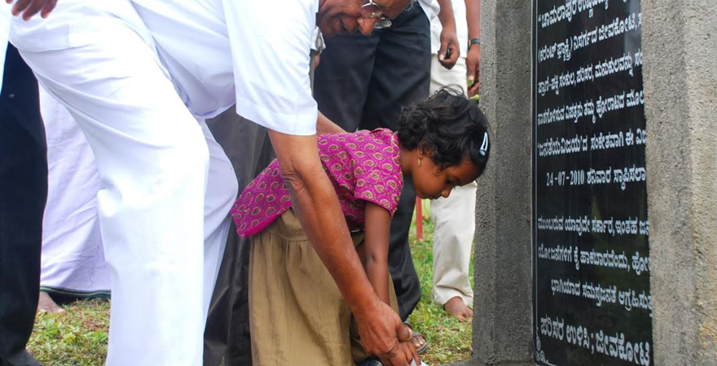
https://ejatlas.org/conflict/chamalapura-thermal-power-plant-karnataka-india

Slide 12

Fikile Ntshangase. https://ejatlas.org/conflict/tendele-coal-mine-somkhele-kwazulu-natal

Slide 13
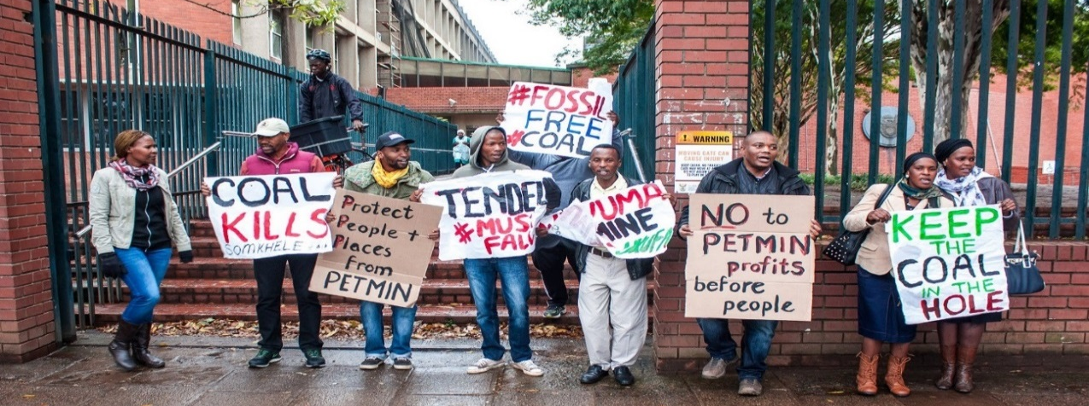
Source: Keep the coal in the hole. 5 Nov. 2020. (Photo Rob Symons). https://www.iol.co.za/the-star/opinion-analysis/mam-ntshangase-murder-lives-of-human-rights-defenders-whistle-blowers-must-be-protected-8ee4ef49-b066-4471-afaa-bd1d7442e8ce.

Slide 14
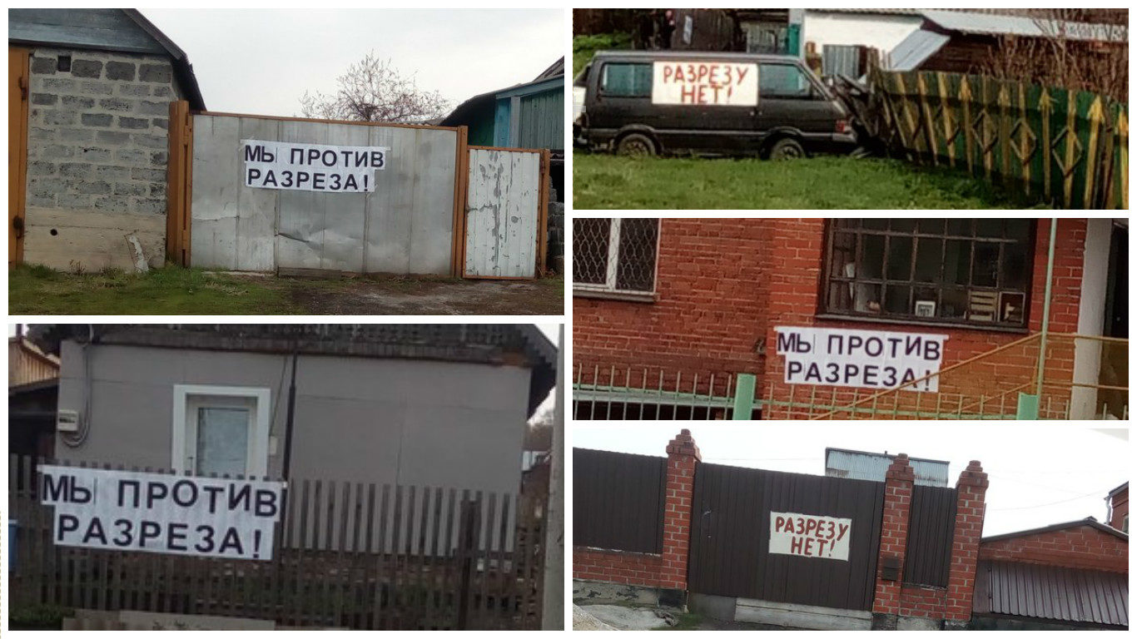
Source: LFFU in Mencherep, Kumerovo oblast. https://ejatlas.org/conflict/mencherep-residents-succesfully-resisting-a-new-open-coal-pit-threatening-their-village

Slide 15
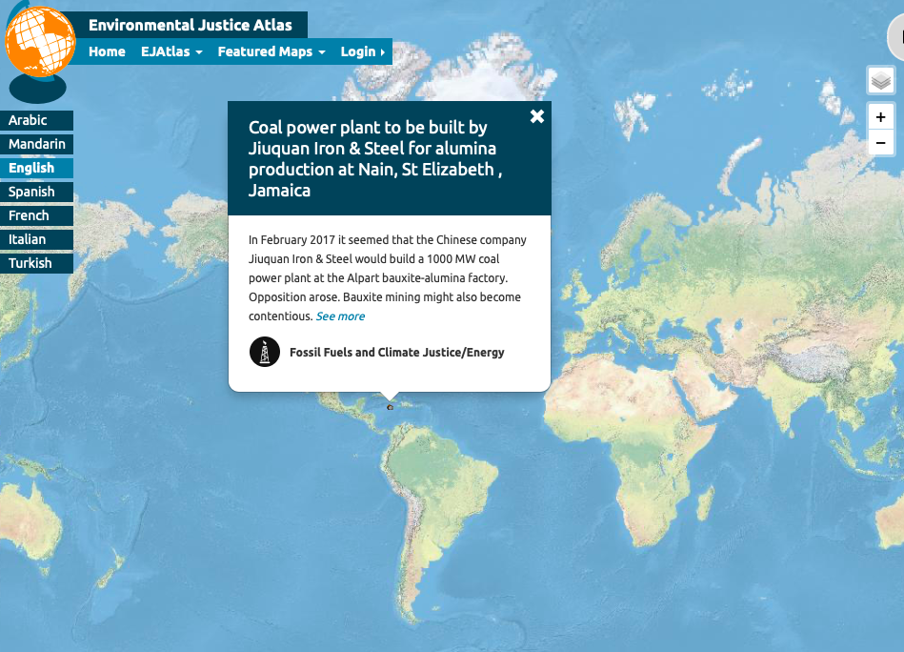

Source: Complaints against CFPP and alumina smelter. https://ejatlas.org/conflict/coal-fired-plant-to-be-built-by-chinese-company-jiuquan-iron-steel-at-nain-st-elizabeth-jamaica

Slide 16
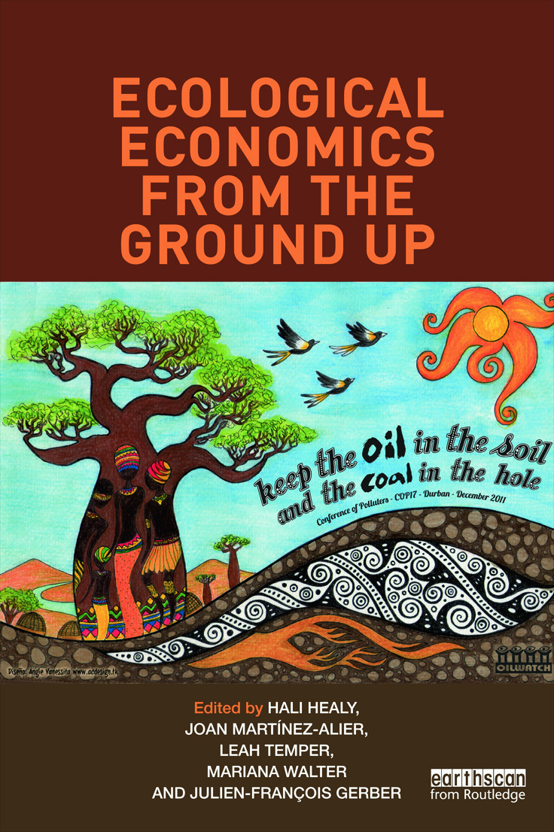
“Keep the oil in the soil, keep the coal in the hole”.
A book published in 2013 from theCEECEC project

Slide 17
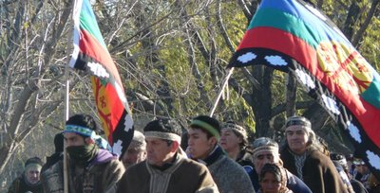
Source: Mapuche demonstration. https://ejatlas.org/conflict/resistance-to-chevron-ypf-fracking

Slide 18
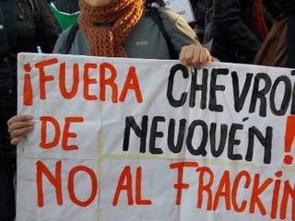
Source: Not to fracking in Neuquén. https://ejatlas.org/conflict/loma-de-la-lata-neuquen-argentina

Slide 19
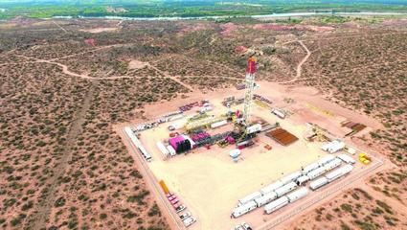
Source: Oil extraction platform in Estación Fernández Oro. https://ejatlas.org/conflict/allen-y-la-extraccion-de-gas-por-fractura-hidraulica

Slide 20
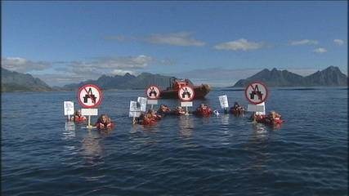
Source: Protest action at Lofoten islands. https://ejatlas.org/conflict/oil-drilling-lofoten-norway

Slide 21
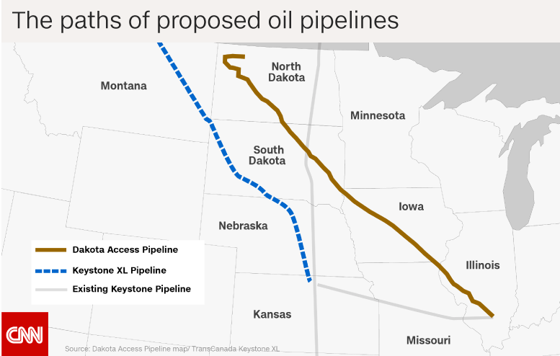
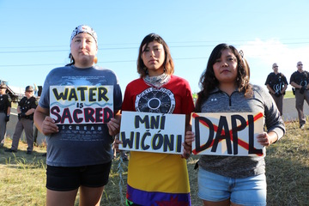
DAPL and Keystone pipelines. More information about these conflicts at https://ejatlas.org/conflict/210000-gallon-oil-spill-from-keystone-pipeline-in-south-dakota
The DAPL. https://ejatlas.org/conflict/dakota-access-pipeline

Slide 22
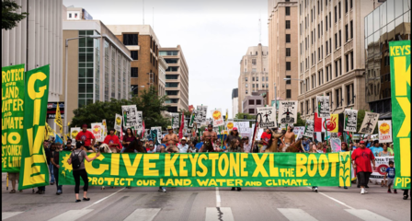
Lincoln, Nebraska. Give Keystone XL the boot, march on 6 August 2017. https://ejatlas.org/conflict/keystone-xl-in-nebraska

Slide 23
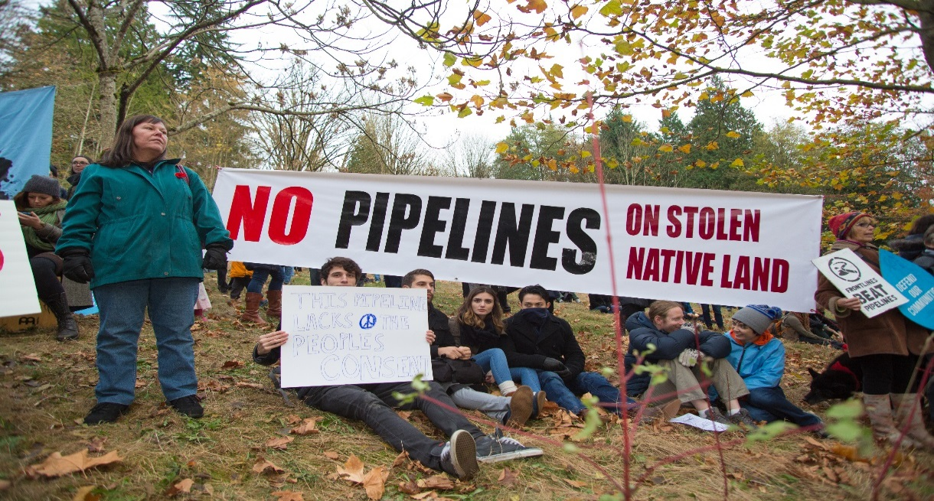
LFFU in Canada. Rally on 17 November 2014. https://ejatlas.org/conflict/the-kinder-morgan-trans-mountain-pipeline-expansion-project-in-british-columbia-canada

Slide 24


Against the TAP in Puglia https://ejatlas.org/conflict/trans-adriatic-pipeline-in-puglia-italy

Slide 25
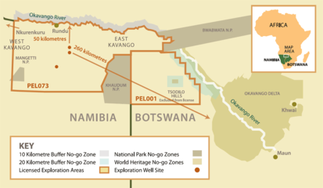
Kavango, Botswana-Namibia https://ejatlas.org/conflict/kavango-oil-botswana-namibia
Plans for oil drilling in Kavango region in Namibia and north-west Botwana near the Okavango Delta where Canadian company ReconAfrica holds explorations licences covering 3 million ha. Esimates from 12,000 million to 120,000 million barrels of oil.

Slide 26
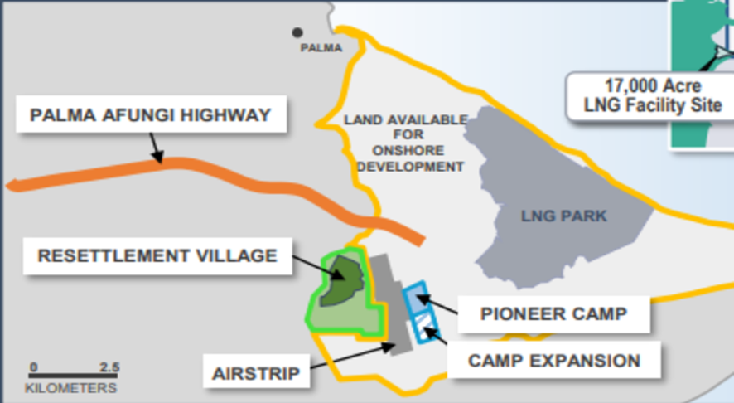
Afungi airport and LNG park. Palma, Cabo Delgado, Mozambique. Source: Anadarko. Stay Grounded. https://ejatlas.org/conflict/afungi-lng-construction-site

Slide 27
Why so many LFFU protests (leave oil in the soil, leave coal in the hole, leave fossil fuels underground)?
Are all these protests geared to avoid climate change?
Protests take place at the extraction frontiers and the waste disposal frontiers. The industrial economy is NOT circular, it is entropic. Of the 100 Gt per year of materials (including energy carriers) entering now the world economy every year, less that 10 Gt are recycled. (W. Haas et al 2015, 2020).

Slide 28
A rough estimate: the world economy produces around 40 billion tons of CO2 per year (35 from the fossil fuels, 5 from land use changes). Very unequal distribution per capita.
But we must reduce by half.
The succesful LFFU, Blockadia, Yasunization/Ogonization cases recorded in the EJAtlas amount perhaps to 5 billion tons (per year).

Slide 29
EJOLT, EnvJustice and EJAtlas main work on Leaving Fossil Fuels Underground (LFFU) www.envjustice.org
1) Towards a Post-oil Civilization. Yasunization and Other Initiatives to Leave Fossil Fuels in the Soil. By Leah Temper et al , EJOLT report n. 6, 2013: http://www.ejolt.org/2013/05/towards-a-post-oil-civilization-yasunization-and-other-initiatives-to-leave-fossil-fuels-in-the-soil/
2) Featured Blockadia Map in the EJAtlas (2018), co-ordinated by Alice Owen and Daria Rivin, Student Researchers at Lund University/ICTA-UAB, and Ende Gelände activists, and Andrea Cardoso of Universidad del Magdalena, Colombia, Brototi Roy and Daniela del Bene, PhD candidates at the Institute of Environmental Science and Technology, Universitat Autònoma de Barcelona. Featured Blockadia map: https://ejatlas.org/featured/blockadia.
3) Blockadia: grassroots movements against fossil fuels and for climate justice (in Spanish). J. Martínez-Alier; Alice Owen; Brototi Roy; Daniela Del Bene, Daria Rivin. Anuari CIDOB. Barcelona, 2018: https://www.raco.cat/index.php/AnuarioCIDOB/article/view/348692
4) Movements shaping climate futures: A systematic mapping of protests against fossil fuel and low-carbon energy projects. By Leah Temper, Sofia Avila, Daniela Del Bene, Jen Gobby, N. Kosoy, Ph. Le Billon, J. Martinez-Alier, Patricia Perkins, Brototi Roy, Arnim Scheidel and Mariana Walter.. Environmental Research Letters,15 (12). 2020: https://iopscience.iop.org/article/10.1088/1748-9326/abc197/meta
5) Koyla Kahini: The Political Ecology of Coal in India. By Brototi Roy. Doctoral thesis, ICTA UAB, 2021: https://www.uab.cat/web/sala-de-premsa-icta-uab/detall-activitat/defensa-de-tesi-de-brototi-roy-1345813172616.html?detid=1345840084873
6) https://www.ecologiapolitica.info/novaweb2/wp-content/uploads/2021/05/Cynthia-Isenhour.JMA_.revised-12May-2021.pdf. Circularity, entropy, ecological conflicts, LFFU. By J. Martinez-Alier.

Slide 30
Thank you joanmartinezalier@gmail.com

